Slide 1
UML Sequence Diagrams (with more class and use-case)
Dr Simon Scola
EurIng Alex Fedorec, Dr Chaoying Ma, Peter Dench

Slide 2

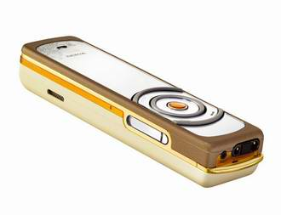


Lectures / ground rules

Slide 3
Recap: Last week
An OO (UML) approach to analysis / design
Class notation
  Association (composition / aggregation)
  Multiplicity
  Specialization / Generalization

Slide 4
SB: What you have seen so far
Development process
  Requirements (Alex)
  Use-case (Simon)
  Objects vs. Classes (Simon)
  Class diagrams (Simon)
  This we look at sequence (Simon)
  Database design (Alex
Requirements
Analysis
Design

Slide 5
Recap: Classes v Objects
 | Interpretation in the real world | Representation in the model
Object: | An object represents anything in the real world that can be distinctly identified | An object has an identity, a state and a behaviour
Class: | A class represents a set of objects with similar characteristics and behaviour. These objects are called instance of the class. | A class characterizes the structure of states and behaviours that are shared by all its instances.
Torres: Player
Player
Xiaoping Jia, Object-Orientated Software Development Using Java: Principles, Patterns and Frameworks, Second Edition, DePaul University, 2003, ISBN 0321210735

Slide 6
Recap: classes
Sale
Product
SaleID: long
TotalCost: float
SaleDate: Date
SalesClerk: Person
ProductID: int
Name: String
Description: String
Supplier: String
Price: float
Customer
CustomerID: long
FirstName: String
LastName: String
Address: String
Postcode: String
Email: String

Slide 7
UML class attributes
What other attributes are there for a Book?
Instance of a Book
Book
myBook: Book
title: String
author: String
price: float
isbn: String
publisher: String
title = “Window XP”
author = “Bill Gates
price = 27.99
Isbn = “2-5345-53245-2”
Publisher = “Microsoft”
copiesOnShelf(): integer
borrow(c:Copy)
copiesOnShelf(): integer
borrow(c:Copy)

Slide 8
Class diagrams: associations
Associations describe relationships between classes
Depicted with a line between the two classes
Associations exist where:
  An object of class A creates an object of class B
  An object of Class A sends a message to object of class B
  An object of Class A receives an Object of Class B as a parameter
  An object of class A has an attribute whose values are object of class B or collections of objects of class B
Customer
Payment

Slide 9
Recap: multiplicity
Shows the number of objects involved in the association
  Specified in the form min..max
    2..8 means between 2 and 8 objects involved in the association
  Can specify as exact number,
    i.e. 6 means exactly 6 objects involved in the association
  Asterix * or n means unspecified amount (i.e. infinite max)
    i.e. 2..* means 2 or more objects involved in the association
    i.e. 2..n means 2 or more objects involved in the association
Example Notation
1 or many product objects are associated with an exactly none or more order objects
1..*
0..*
Product
Order

Slide 10
Recap: Aggregation
Introduces no new rules it just adds vocabulary to the notation
Aggregation in UML means ‘has a’ or ‘is part of’
Notation:
Meaning:
    between 1 and 6 modules are part of 1 or more programme
2..6
1..*
Course
Programme

Slide 11
Recap: Composition
Composition introduces new rules as the objects are intrinsically tied together
Composition in UML means ‘contains’
Composition is a strong form of association
i.e. the life and death of the associated objects coincide
Notation:
Meaning:
Exactly 1 printer object contains between 1 and 2 printBuffer objects
Delete the printer and you also delete is printBuffer
1
1..2
Printer
PrintBuffer

Slide 12
Class diagrams: Inheritance
Notation:
Meaning:
    Circle is a Shape
    Circle is everything a Shape is with the extra specialisation of a radius attribute
Shape
Circle
x: int
y: int
radius: int
display(): void

Slide 13
Recap: Specialisation with Realisation
Example with instances
A UML note
Shape
Circle
x: int
y: int
radius: int
display(): void
<<instance of>>
<<instance of>>
aCircle: Circle
aShape: Shape
x =10
y = 20
Radius = 60
x =10
y = 20
display(): void
display(): void

Slide 14
Recap: CD
cd CAD package
And we have added some multiplicity
CAD
A UML note
1
1
1
1
Canvas
0..n
Shape
Circle
Square
Triangle

Slide 15
CD: Natural language helper
Object? Sub/super-class? Aggregation?
  Is-a → Object
  Is-a-kind-of → Sub-class
  Defines a-kind-of → Super-class
  Has-a → Aggregation
    but could not exist without → Composition
      Life and death coincide → probably Composition
      Created by and within a class → probably Composition
    Imported (existed outside the class) → Aggregation
System Building 1 PPSDench

Slide 16
Sequence diagrams

Slide 17
This week
Sequence diagrams
  or… more precisely
OO Analysis and Design
  Use-case & Class Diagrams.. then..
    Sequence diagrams
Notes:
Shows the objects and actors that take part in a collaboration at the top of the dash lines
The line represents time – time that is from the object’s perspective
The line represents the life-line of the object
Time passes from top to bottom
Message between objects are shown as arrows
NB Good technique that enhances readability is to show objects used early in the sequence to the left of the diagram
The rectangles represent an activation for the object
A shaded area can be used to further define the period that the object is performing some processing and execution instructions

Slide 18
SD: What is a Sequence diagram
Show the objects and actors that take part in a collaboration
Show a sequence of events
Show messages that are sent between objects involved in a collaboration
Typically a SD is for a scenario
  (perhaps from a use-case)
Notes:
Shows the objects and actors that take part in a collaboration at the top of the dash lines
The line represents time – time that is from the object’s perspective
The line represents the life-line of the object
Time passes from top to bottom
Message between objects are shown as arrows
NB Good technique that enhances readability is to show objects used early in the sequence to the left of the diagram
The rectangles represent an activation for the object
A shaded area can be used to further define the period that the object is performing some processing and execution instructions

Slide 19
Investigating the library scenario
BUT! We need to have some understanding of the problem we are investigating before we can construct a sequence diagram
In other words..
    We could interview clients to find out requirements
    We could construct use-case diagrams from those requirements
    We could construct class diagrams based on the above

Slide 20
Investigating the library scenario
Actions / behaviours / events (i.e. verbs) help us to construct a use-case (use-case = behaviour)
An example library scenario
  The library holds many copies of books
  A copy of a book can be borrowed or returned by library members (subject to availability & maximum loans)
  A member of staff is also allowed to borrow journals
  A member of staff is a library borrower
  etc..

Slide 21
Investigating the library scenario
Actions / behaviours / events (i.e. verbs) help us to construct a use-case (use-case = behaviour)
An example library scenario
  The library holds many copies of books
  A copy of a book can be borrowed or returned by library members (subject to availability & maximum loans)
  A member of staff is also allowed to borrow journals
  A member of staff is a library borrower
  etc..

Slide 22
Investigating the library scenario
Things (i.e. nouns) help us to determine classes / objects (class = structure)
An example library scenario
  The library holds many copies of books
  A copy of a book can be borrowed or returned by library members (subject to availability & maximum loans)
  A member of staff is also allowed to borrow journals
  A member of staff is a library borrower
  etc..

Slide 23
Investigating the library scenario
Things (i.e. nouns) help us to determine classes / objects (class = structure)
An example library scenario
  The library holds many copies of books
  A copy of a book can be borrowed or returned by library members (subject to availability & maximum loans)
  A member of staff is also allowed to borrow journals
  A member of staff is a library borrower
  etc..

Slide 24
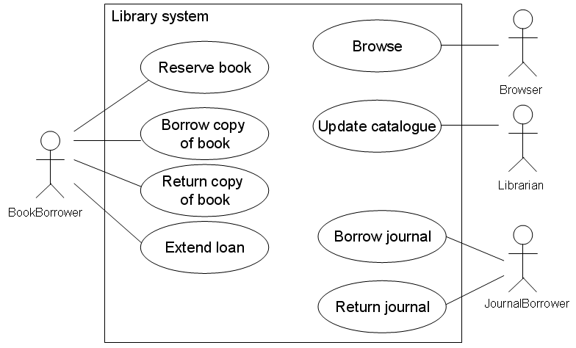
UC: investigating the library scenario
An initial UC (use-case)
UC Library Borrowing

Slide 25
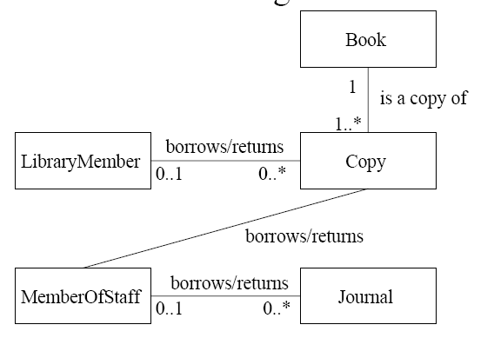
CD: investigating the library scenario
An initial CD (class diagram)
CD Library Borrowing

Slide 26
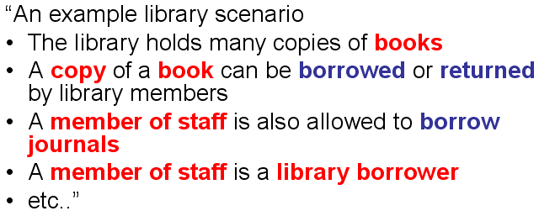
CD: investigating the library scenario
But wait!
  Is MemberOfStaff a specialisation of LibraryMember?
  MemberOfStaff can do everything a LibraryMember can do WITH the extra behaviour that they can borrow journals
Recall from last week that the ‘is a’ language hints towards a generalisation

Slide 27
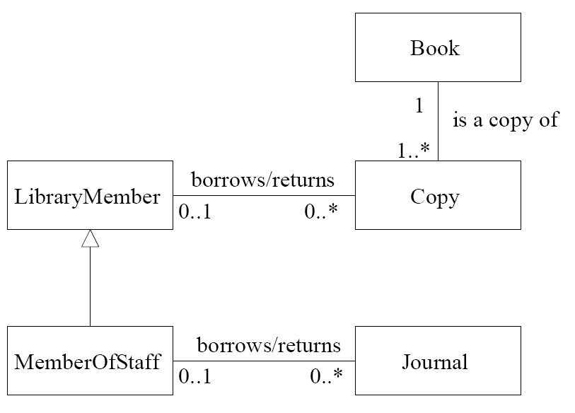
CD: investigating the library scenario
Revised class diagram
  We now need to revise our use-case diagram to reflect our *improved* class diagram
CD Library Borrowing

Slide 28
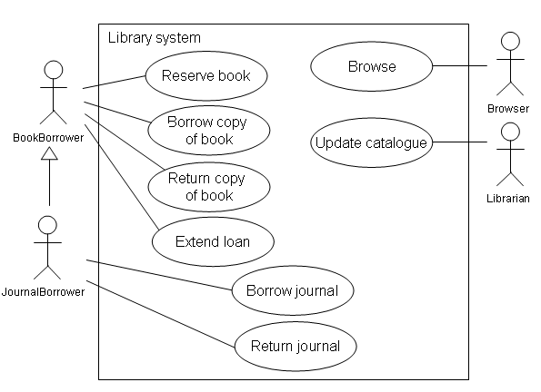
UC: investigating the library scenario
Updated UC (includes specialisation)
UC Library Borrowing

Slide 29
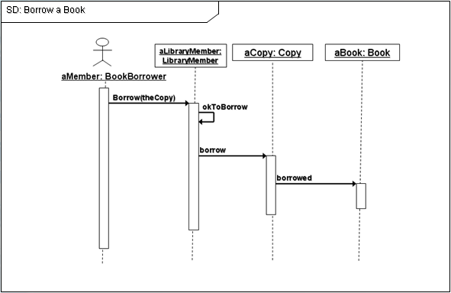
SD: investigating the library scenario
A Sequence diagram depicts:
  The sequence (order) of events
  The objects / classes involved
  The message passing between objects / classes
A Sequence diagram depicts one or more use-case

Slide 30
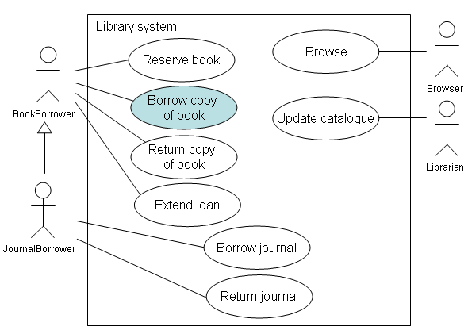
SD: investigating the library scenario
  Let’s model the Borrow Book (marked in blue) use-case
UC Library Borrowing

Slide 31
IMPORTANT
We need some CLASSES and ACTORS before we can attempt a sequence diagram.
  Pre-requisites
    Step 1: make a use-case analysis
    Step 2: make a class diagram
Some of your classes will appear in the Sequence Diagram.
Some of your actors will initiate sequences

Slide 32
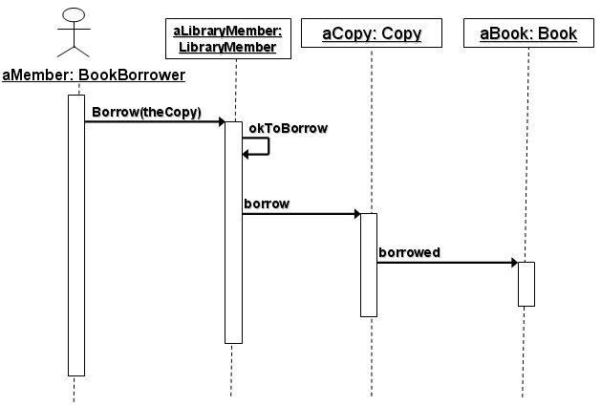
Example of a SD
Notice the diagram name is the same as the use-case
END
SD Borrow a Book
SD Borrow copy of Book

Slide 33
What does it all mean?
aMember: BookBorrower
aMember is going to play the role of a BookBorrower
A UML note
Note the format
Stickman = an actor
labeled as Object: Class
A UML note
The dashed line is the life line of the actor
A UML note

Slide 34
aMember begins to do something (denoted by an activation WHITE bar)
A UML note
aMember: BookBorrower

Slide 35
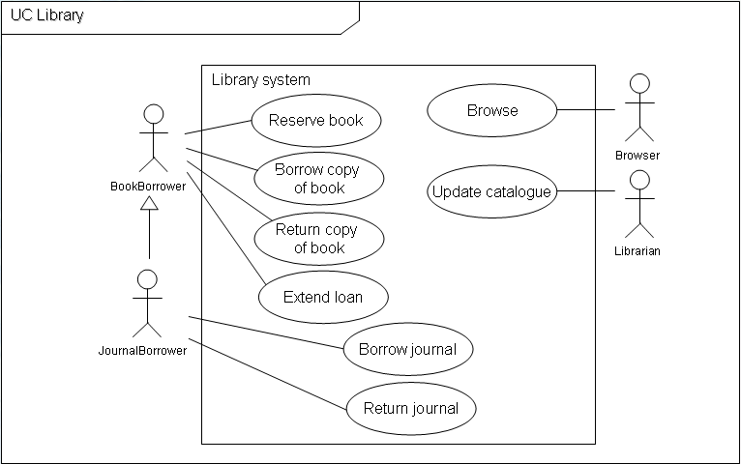
The LibraryMember class handles ALL of the behavior of a library member
A UML note
aLibraryMember: LibraryMember
aMember: BookBorrower
In other words, our LibraryMember class will be able to do anything that a real world Library member will be able to do.
i.e. the tasks we identified on the use-case
A UML note
Notice that the LibraryMember class also has a dashed life line
A UML note

Slide 36
aMember begins to do something (denoted by an activation WHITE bar)
aLibraryMember: LibraryMember
A UML note
aMember: BookBorrower
Borrow(theCopy)
aMember invokes a behaviour of a LibraryMember - the behaviour of borrowing a copy of a book
A UML note
The notation:
An arrow showing the method
A UML note
Borrow(theCopy)

Slide 37
aLibraryMember: LibraryMember
aMember: BookBorrower
The LibraryMember begins to do something. In other words it becomes active (denoted by the activity white bar)
A UML note
Borrow(theCopy)
In other words the LibraryMember class begins to perform the behavior involved with borrowing a copy of a book
A UML note

Slide 38
This might involve checking whether it is okay for the LibraryMember to borrow a book
A UML note
aLibraryMember: LibraryMember
aMember: BookBorrower
LibraryMembers have a maximum number of loans permitted at anyone time
They may have fines, etc.
They can only borrow the copy if the rules of the business allow.
A UML note
Borrow(theCopy)
okToBorrow
Notice the arrow points to itself. This indicates the activation of a behaviour belonging to itself.
Known as ‘self activation’
A UML note
okToBorrow

Slide 39
Once it is determined that it is OkToBorrow the copy of the book. The LibraryMember class tells the individual copy that it is being copied
aLibraryMember: LibraryMember
A UML note
aMember: BookBorrower
Borrow(theCopy)
okToBorrow
It therefore need to send a message to the copy of the book.
See Next Slide
borrow
A UML note

Slide 40
aLibraryMember: LibraryMember
aCopy: Copy
aMember: BookBorrower
We add the Copy of the book as a rectangle
(i.e. object : class)
A UML note
Borrow(theCopy)
okToBorrow
borrow
We also add the lifeline
A UML note

Slide 41
The Copy of the Book activates, i.e. it starts to do the behavior involved with borrowing itself
A UML note
aLibraryMember: LibraryMember
aCopy: Copy
aMember: BookBorrower
Borrow(theCopy)
okToBorrow
This behaviour might involve changing an attribute called ‘status’ to ‘onloan’
A UML note
borrow
Excellent, our SD is revealing more than just behavior, its also helping us find some attributes (we would need to change our class diagram later)
A UML note

Slide 42
As part of the behavior involved with borrowing itself, a copy of a Book might notify the Book class to tell it to reduce the number of copies on the shelf and to increase the number of copies on loan
A UML note
aLibraryMember: LibraryMember
aCopy: Copy
aMember: BookBorrower
Borrow(theCopy)
okToBorrow
borrow
borrowed
the Copy can do this by invoking a behaviour of the Book class.
A UML note

Slide 43
aLibraryMember: LibraryMember
aCopy: Copy
aBook: Book
aMember: BookBorrower
We add a Book Class (the rectangle at the top) and a life line.
A UML note
Borrow(theCopy)
okToBorrow
borrow
borrowed

Slide 44
aLibraryMember: LibraryMember
aCopy: Copy
aBook: Book
aMember: BookBorrower
The Book becomes active and makes some changes to its data:
copiesOnShelf=-1
copiesOnLoan=+1
Borrow(theCopy)
A UML note
okToBorrow
borrow
borrowed

Slide 45
aLibraryMember: LibraryMember
aCopy: Copy
aBook: Book
aMember: BookBorrower
So that’s it!
We have captured the sequence of events involved with a BookBorrower borrowing a copy of a book
Borrow(theCopy)
A UML note
okToBorrow
borrow
borrowed

Slide 46
CD: investigating the library scenario
  We could now improve out class diagram to reflect our expanded understanding of the scenario
CD Library
Book
This CD only shows the extra information that we learnt from our SD
copiesOnShelf: int
copiesOnLoan: int
A UML note
borrowed()
1
1..*
LibraryMember
Copy
maximumLoansAllowed: int
noCurrentLoans: int
status: String
borrow()
0..1
0..*
okToBorrow()
borrow(aCopy)

Slide 47
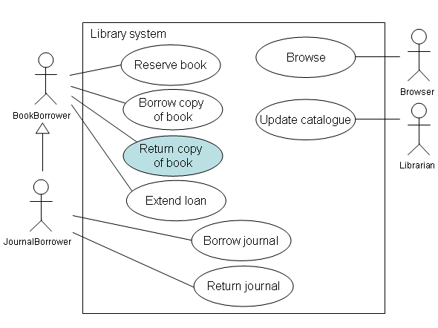
SD: investigating the library scenario
  Let’s design a SD the Return Copy of Book (marked in blue) use-case
UC: Library Borrowing

Slide 48
aLibraryMember: LibraryMember
aCopy: Copy
aBook: Book
aMember: BookBorrower
Easy
A UML note
return(theCopy)
return
returned

Slide 49
CD: investigating the library scenario
  We could now improve out class diagram to reflect our expanded understanding of the scenario
CD Library
Book
We add the additional behavior
copiesOnShelf: int
copiesOnLoan: int
A UML note
borrowed()
returned()
1
1..*
LibraryMember
Copy
status: String
borrow()
return()
0..1
0..*
okToBorrow()
borrow(aCopy)
return(aCopy)

Slide 50
SD: Sequence diagrams
Things to note
  Diagram is read from top to bottom
  An message between two classes implies an association
  The owner of the behaviour is the recipient of the message
  Typically only a single thread of execution is shown in a SD
  There is more to SD.. but this is a good start
Notes:
Shows the objects and actors that take part in a collaboration at the top of the dash lines
The line represents time – time that is from the object’s perspective
The line represents the life-line of the object
Time passes from top to bottom
Message between objects are shown as arrows
NB Good technique that enhances readability is to show objects used early in the sequence to the left of the diagram
The rectangles represent an activation for the object
A shaded area can be used to further define the period that the object is performing some processing and execution instructions

Slide 51
Who owns the behaviour?
aLibraryMember: LibraryMember
aCopy: Copy
aBook: Book
aMember: BookBorrower
return(theCopy)
return
returned

Slide 52
Who owns the behaviour?
aLibraryMember: LibraryMember
aCopy: Copy
aBook: Book
aMember: BookBorrower
Borrow(theCopy)
okToBorrow
borrow
borrowed

Slide 53
SD: Sequence diagrams
UML 2.0 can also show iteration and selection through the use of combination fragments
  Alternatives (Alt in UML)
  Options (Opt in UML)
  Loops (Loop in UML)
Also using combination fragments
  Bres and
  Parallel processing
We cover some of this next semester
Notes:
Shows the objects and actors that take part in a collaboration at the top of the dash lines
The line represents time – time that is from the object’s perspective
The line represents the life-line of the object
Time passes from top to bottom
Message between objects are shown as arrows
NB Good technique that enhances readability is to show objects used early in the sequence to the left of the diagram
The rectangles represent an activation for the object
A shaded area can be used to further define the period that the object is performing some processing and execution instructions

Slide 54
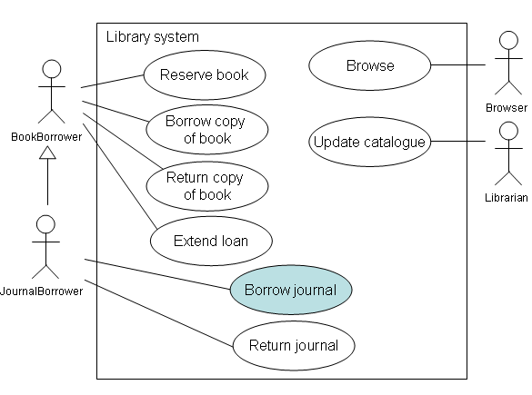
SD: Sequence diagrams
Now you try to design a SD for the Borrow Journal use-case (marked in blue)
UC Library
Notes:
Shows the objects and actors that take part in a collaboration at the top of the dash lines
The line represents time – time that is from the object’s perspective
The line represents the life-line of the object
Time passes from top to bottom
Message between objects are shown as arrows
NB Good technique that enhances readability is to show objects used early in the sequence to the left of the diagram
The rectangles represent an activation for the object
A shaded area can be used to further define the period that the object is performing some processing and execution instructions

Slide 55
Finally
OOAD & UML tips:
  If a diagram is too complex to draw by hand then its probably to complex to comprehend and loses its value.
    Keep it Simple Stupid (KISS)
  Represent reality
    OOAD aims to represent reality rather than some convenient for a computer (or you) view of reality.
    Reality has a habit of changing.
    We can handle change better by representing the real world objects/class structure, behaviours rather than some hacked fabrication of reality
Notes:
Shows the objects and actors that take part in a collaboration at the top of the dash lines
The line represents time – time that is from the object’s perspective
The line represents the life-line of the object
Time passes from top to bottom
Message between objects are shown as arrows
NB Good technique that enhances readability is to show objects used early in the sequence to the left of the diagram
The rectangles represent an activation for the object
A shaded area can be used to further define the period that the object is performing some processing and execution instructions

